Slide 1

RUNGTA COLLEGE OF DENTAL SCIENCES AND RESEARCH
MENINGITIS
DEPARTMENT OF GENERAL MEDICINE

Slide 2
SPECIFIC LEARNING OBJECTIVES
MUST KNOW | NICE TO KNOW | DESIRE TO KNOW
WHAT IS BACTERIAL MENINGITIS | TRANSMISSION | RISK FACTORS
CAUSES | DIAGNOSIS | MENINGITIS AND PREGNANCY
SIGN AND SYMPTOMS | ASEPTIC MENINGITIS | VACCINATION
TREATMENT | VIRAL MENINGITIS | PARASITIC MENINGITIS
 |  | NON INFECTIOUS MENINGITIS

Slide 3
CONTENTS
INTRODUCTION
CAUSES
WHAT IS BACTERIAL MENINGITIS ?
RISK FACTORS
MENINGITIS AND PREGNANCY
SIGNS AND SYMPTOMS
TRANSMISSION
DIAGNOSIS
TREATMENT
VACCINATION
ASEPTIC MENINGITIS
VIRAL MENINGITIS
PARASITIC MENINGITIS
NON INFECTIOUS MENINGITIS
CONCLUSION

Slide 4
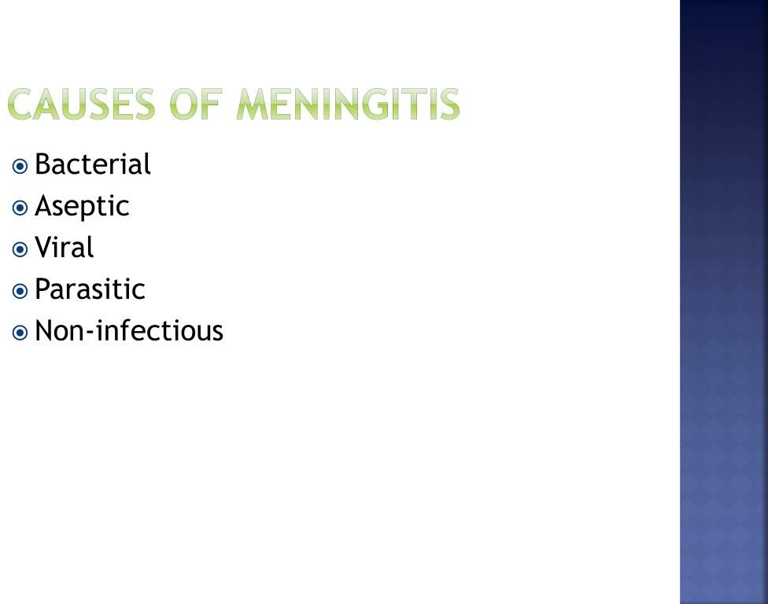

Slide 5
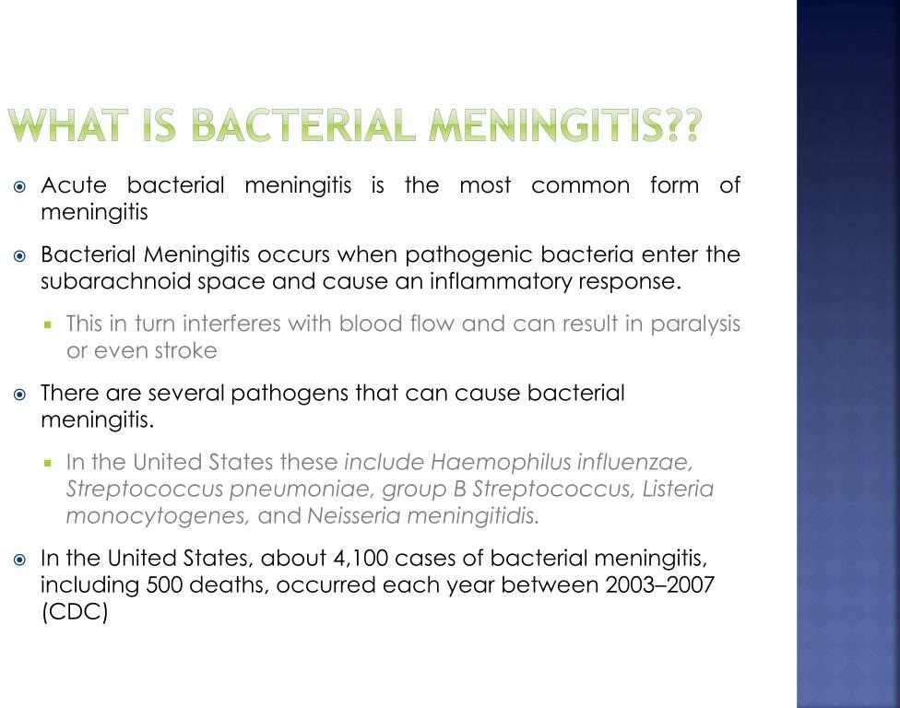

Slide 6
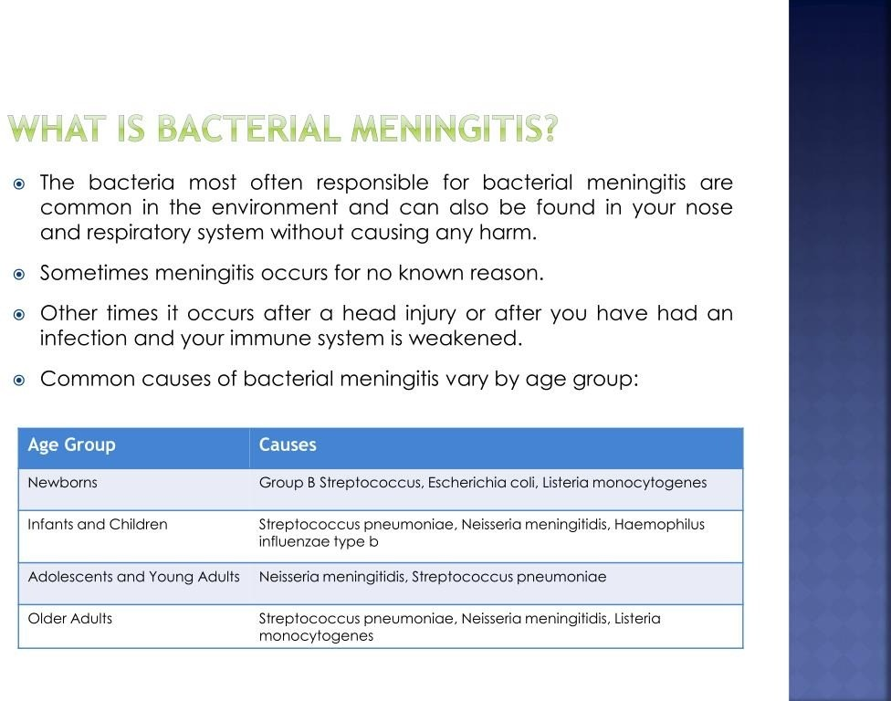

Slide 7
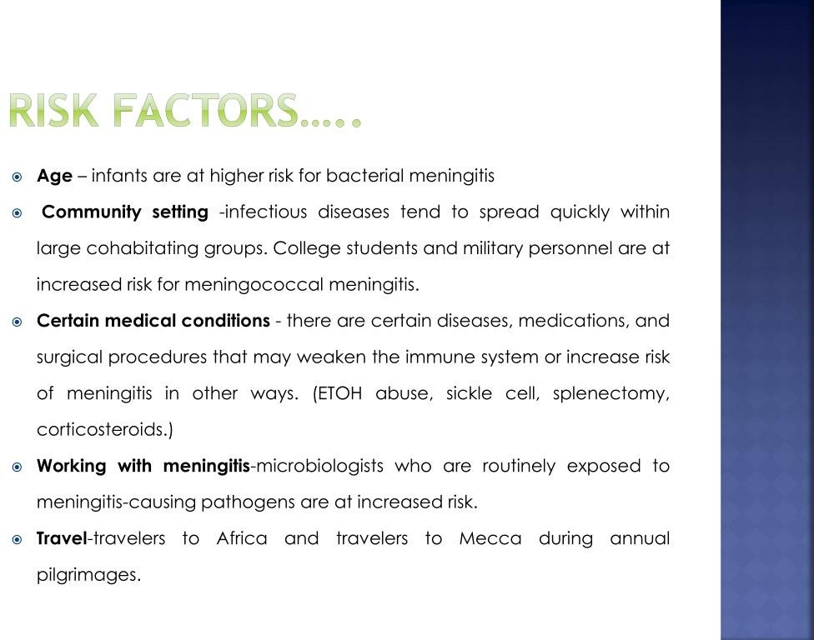

Slide 8
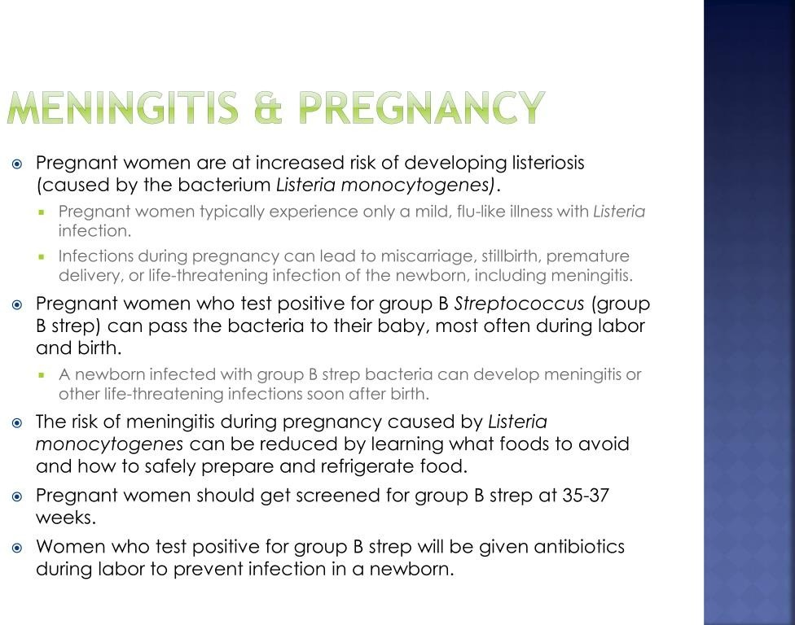

Slide 9
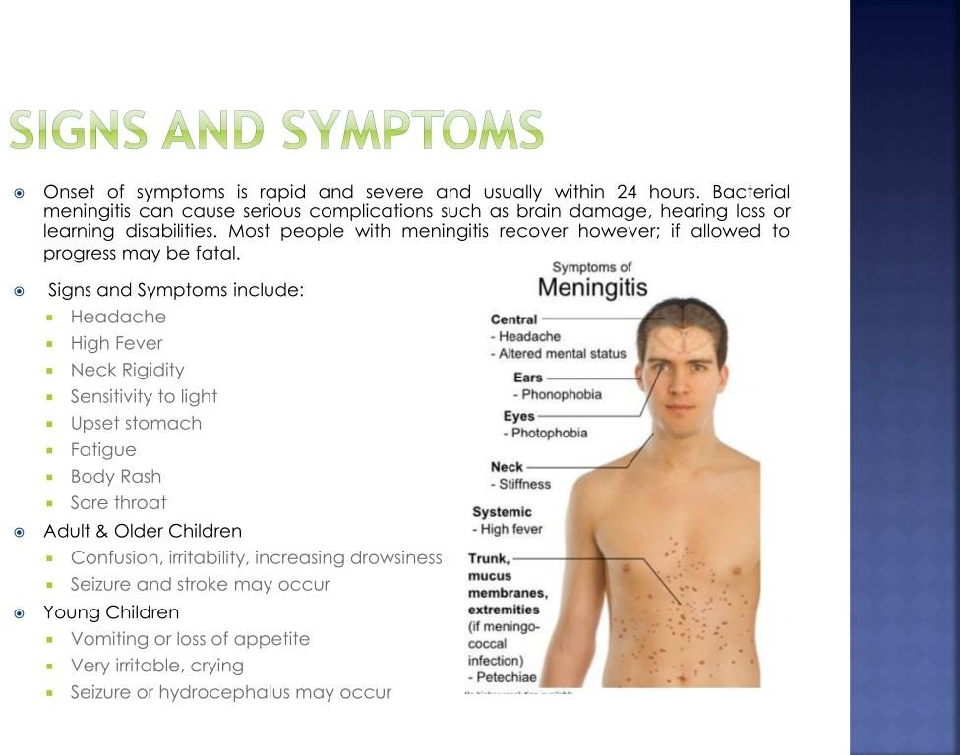

Slide 10
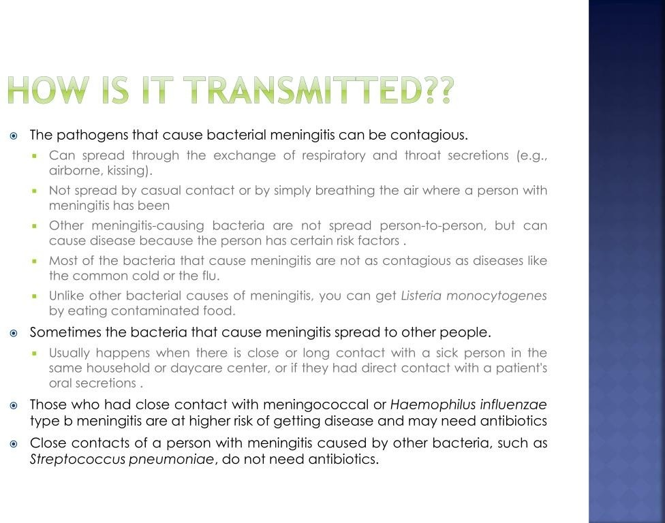

Slide 11
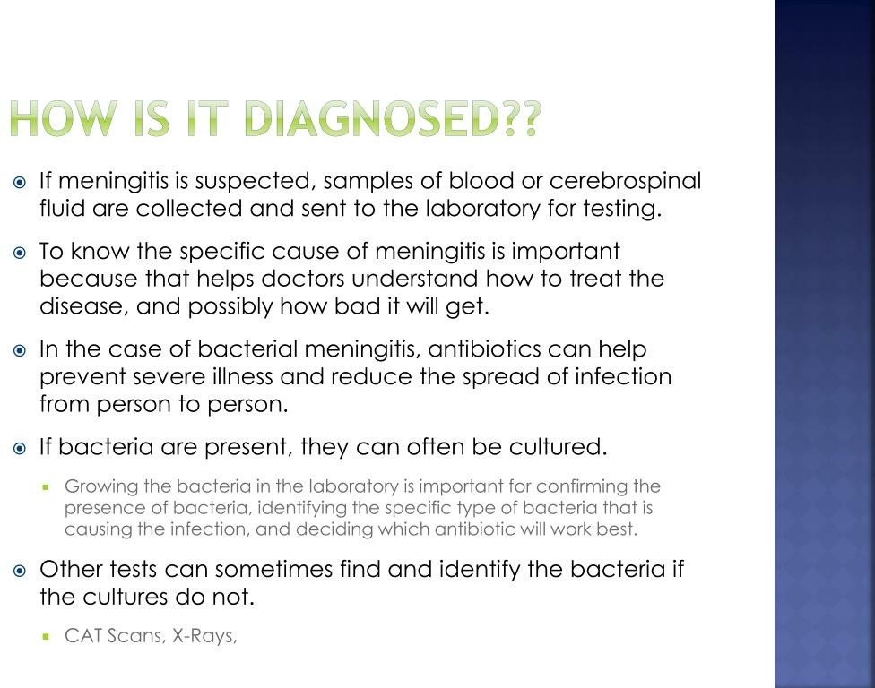

Slide 12
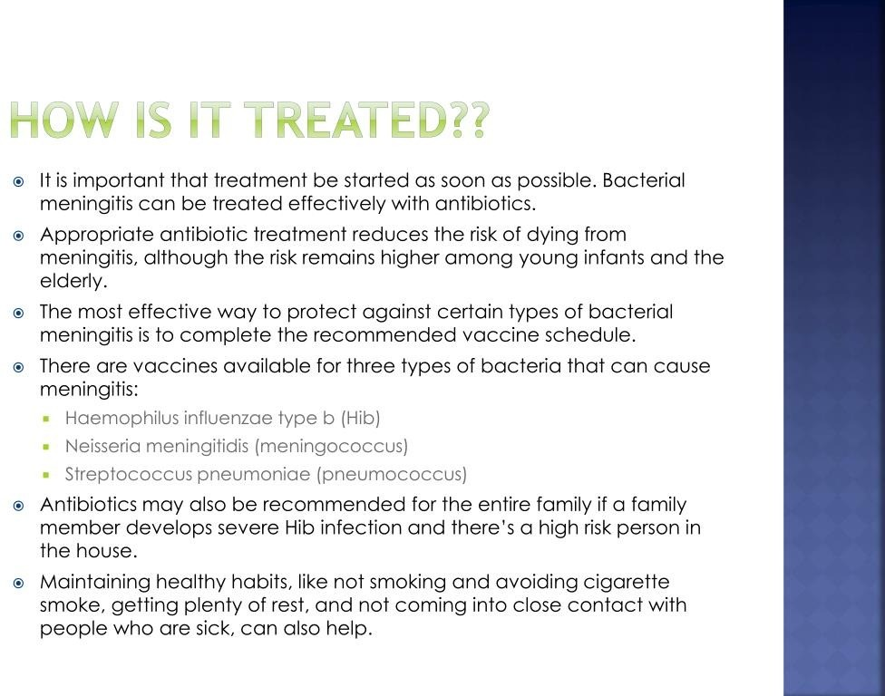

Slide 13
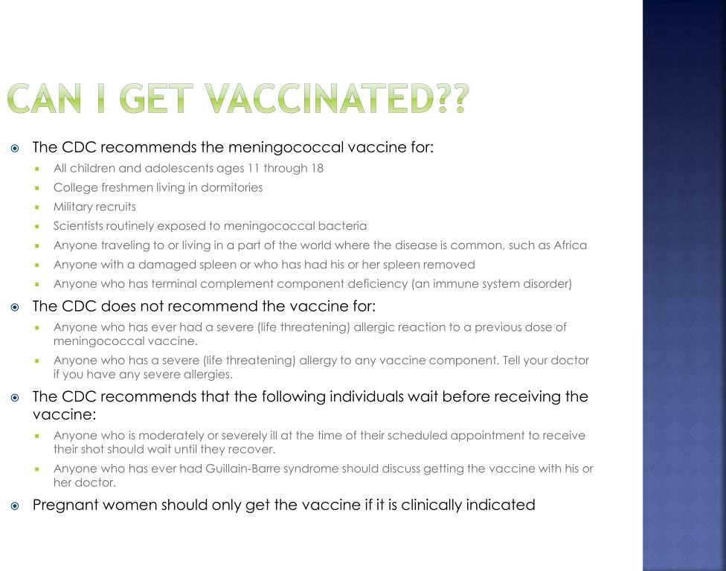

Slide 14
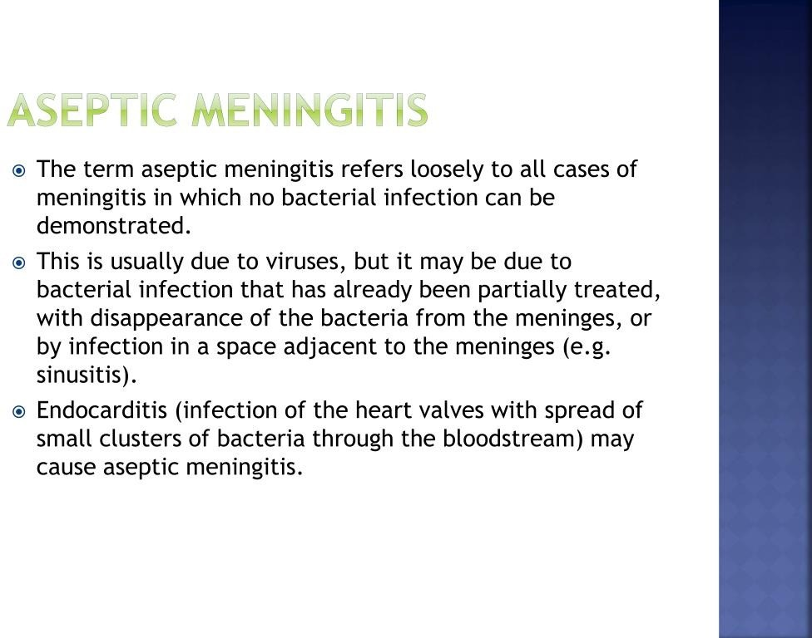

Slide 15
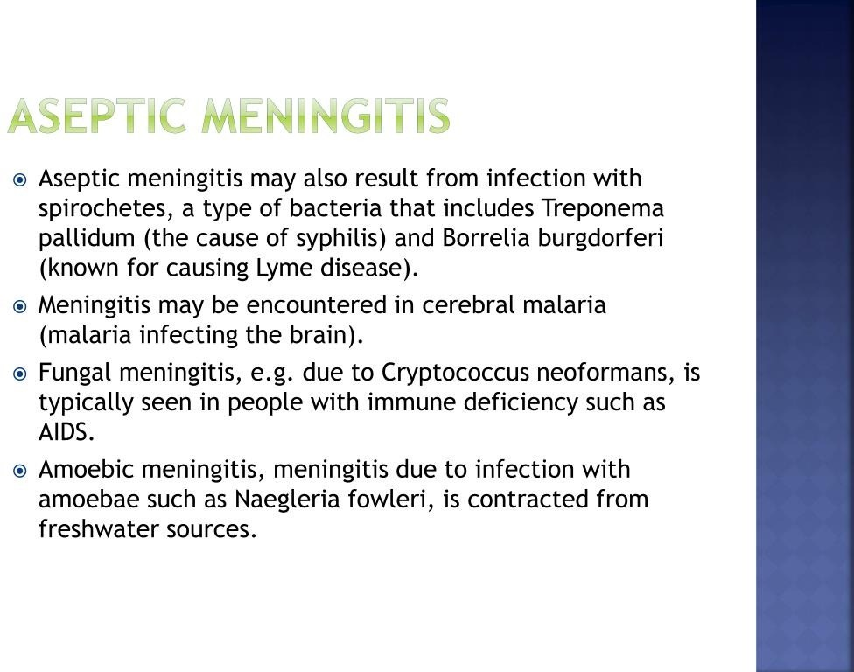

Slide 16
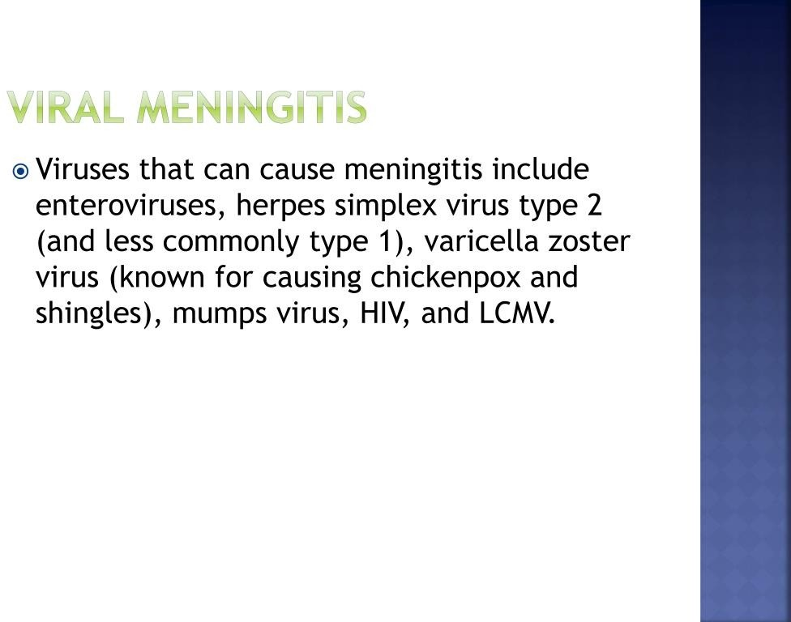

Slide 17
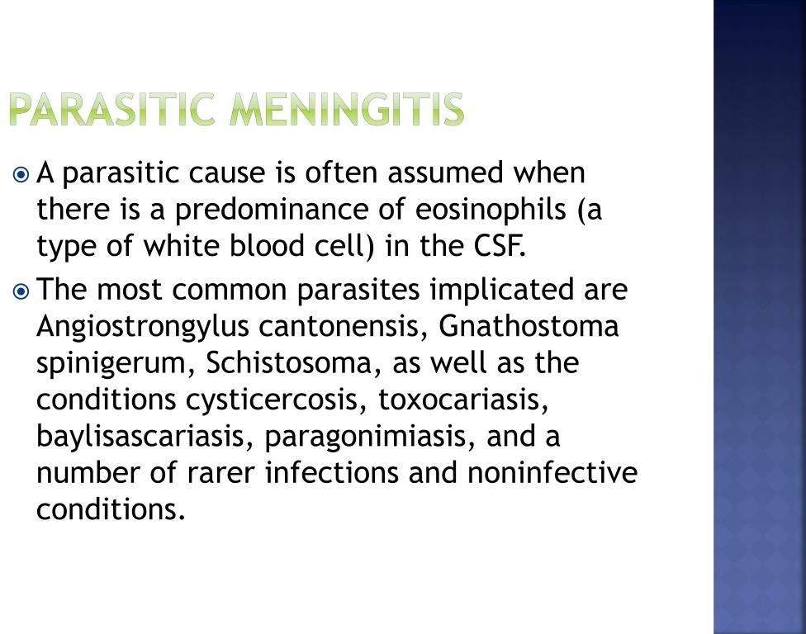

Slide 18
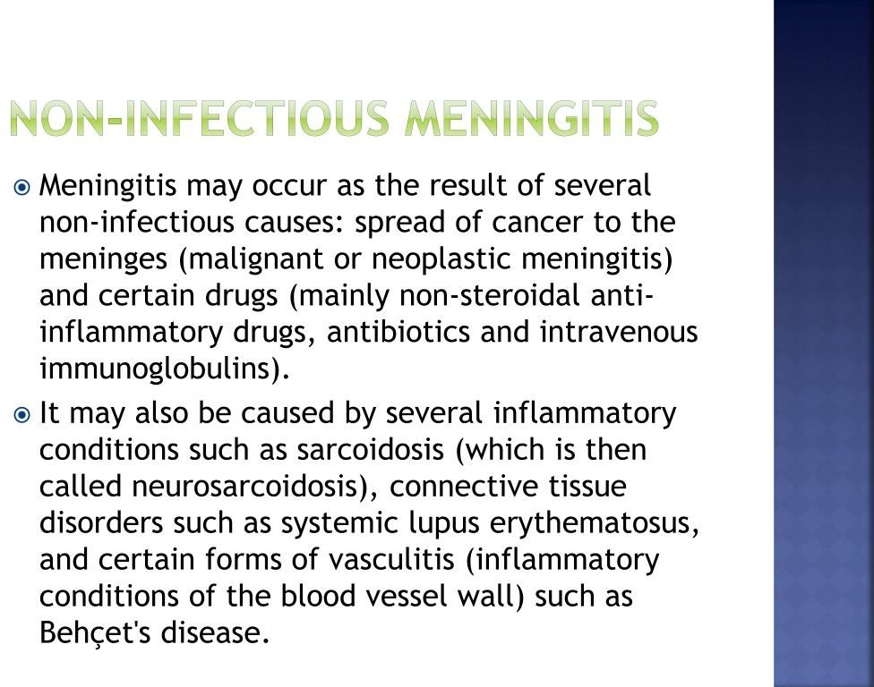

Slide 19
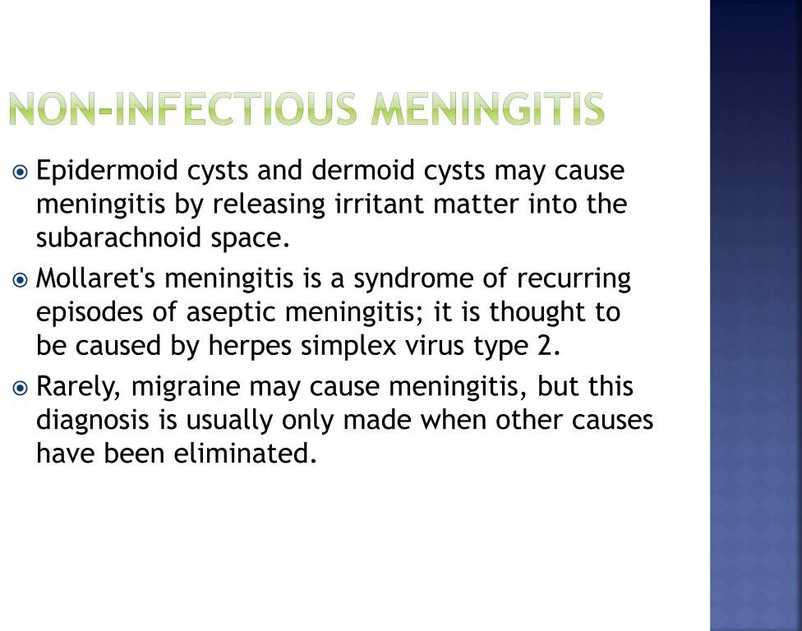

Slide 20
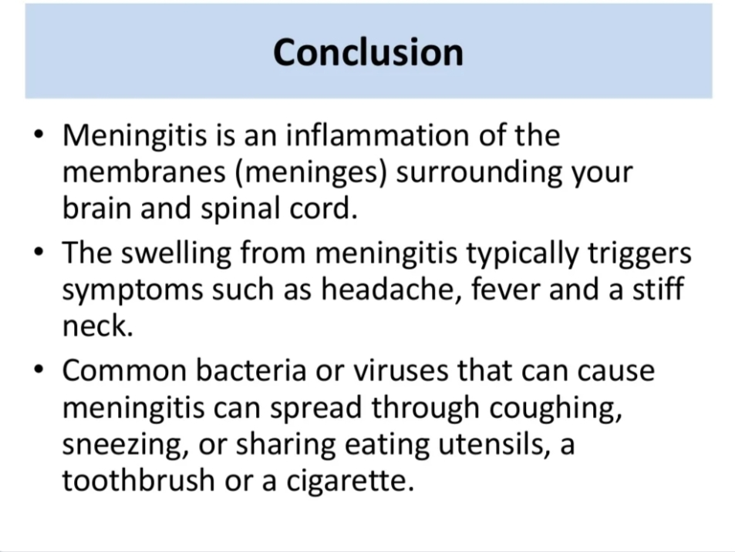

Slide 21
REFERENCES
DAVIDSON’S PRINCIPLES AND PRACTICE OF MEDICINE; 23rd edition
HARRISON’S PRINCIPLE OF INTERNAL MEDICINE; 21ST edition
TEXTBOOK OF CLINICAL MEDICINE by S.N Chugh ;5th edition

Slide 22
QUESTIONS AND ANSWERS

Slide 23
THANK YOU.....

